Slide 1
Session 9
Software Implementation and CASE

Slide 2
Review
Maintenance activities involve making enhancements to the software products developed in the earlier stages of the life cycle, adapting products to new environments and correcting problems.
Maintenance activities account for a large portion of the system life cycle costs, even as much as 60-70 percent of the total costs set aside for the project.
Corrective maintenance involves testing and diagnosis, then designing and making changes to get the system to do what it was expected to do.
Perfective maintenance involves designing and enhancing the system to perform better than it was originally expected to do.
Adaptive maintenance is a subset of perfective maintenance and comes into picture when we wish to take advantage of the latest technological advancements.

Slide 3
Review Contd…
Preventive maintenance is also called reengineering.
Issues related to software maintenance include:
  Lack of documentation
  Dynamic personnel
  Motivation or morale
  Patchy code
  Outdated technology
  Round-the-clock operations
Maintenance metrics can be calculated based on the following factors:
  System availability
  Maintenance turnaround
  Productivity

Slide 4
Objectives
Analyze why Implementation is an important phase of SDLC
Discuss the various activities of Implementation Phase
Discuss the various Implementation Strategies
Discuss the need for Contingency Planning and Post Implementation Maintenance
Learn the meaning of CASE and its evolution
Discuss the classification of CASE
Correlate the use of CASE to software engineering concept
Discuss CASE Toolkits, CASE Methodology companion, CASE Workbench, Repository features

Slide 5
Activities
Creating an Installation Plan
Implementing physical procedure
Preparing and Converting data
Conducting User Training
Running the system

Slide 6
Installation Plan
Purchase of hardware
Preparation of site
Purchase of environmental software
Installation of developed software
Training

Slide 7
Physical Procedure
An organization will follow simultaneously with the automated system
Spells the transition from old to the new system
Requires handling of user training

Slide 8
Data Conversion
List all existing files to be converted
List new files to be created and data required for it
List all new documents and procedures that go into use during conversion
Identify controls for the conversion process
Prepare conversion schedule
Assign responsibility for each task

Slide 9
User training
Two levels of training
  Training for systems operations
  Training for users of the system

Slide 10
Training for system operators
How the equipment has to be used
Minor troubleshooting
Maintenance activities and their frequency

Slide 11
Training for end-users
Using the equipment
Using the application
Using the data
Adding, deleting and editing of records
Retrieving information from the system
Utilizing the system generated information
Elementary troubleshooting

Slide 12
Parallel Run
The running of old and new systems together
Factors to be considered
  No major faults in the package
  Important figures tally
  All modules are used and found satisfactory
  Fair amount of confidence amongst users in being able to use the software
Users approve implementation when they are fully satisfied

Slide 13
Post Implementation Review
Has the information system reduced/ increased the operating cost of application
Does the system provide accurate and up-to-date information in desirable formats?
Has the new system improved the way systems were operated earlier?
Does the new system need more or less number of users/ operators than before?
Has the new system affected the procedures of the organization?
Has the new system improved productivity ?
Has the new system improved service to customers?

Slide 14
Implementation Strategies
Parallel run
Direct Cutover
Phased Approach
Pilot Approach

Slide 15
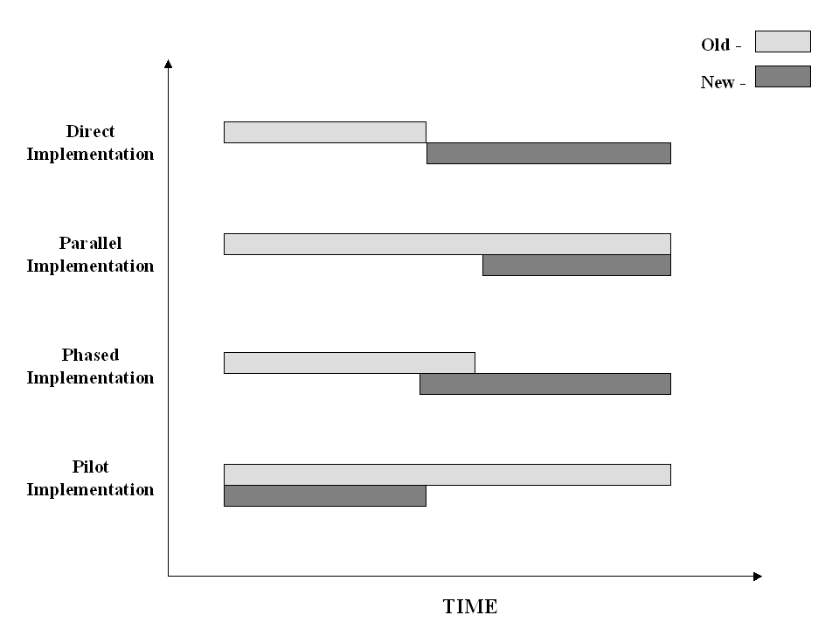
Implementation Strategies Contd…

Slide 16
Implementation Strategy – Choosing Factors
Nature and size of application
Type of organization
Existence of an internal EDP environment
Number of personnel involved in usage of software
Data volumes
Location spread of the application
Availability of certain tools
Manpower availability
Criticality of the application

Slide 17
Data Conversion
When data is available as part of some existing application
When application is being automated for the first time
When volumes of data are very high

Slide 18
Contingency Planning
Another backup machine
Leased time
Service from another location
Manual System

Slide 19
Post Implementation Maintenance
Troubleshoot problems
Modify the system when and if bugs are discovered
Modify the system for changed requirements of the user

Slide 20
Documentation
Installation manual
Operations manual
User manual

Slide 21
CASE
Computer Aided Software Engineering
Enables people working on a software project to store data about a project
  Plan and schedule
  Track the progress
  Analyze and store data about user requirements
  Store the design of a system
Aids a software engineer to maintain and develop software
Automates the principles of software engineering

Slide 22
CASE Tools
Production-process support technology
Process Management Technology
Meta-case Technology

Slide 23
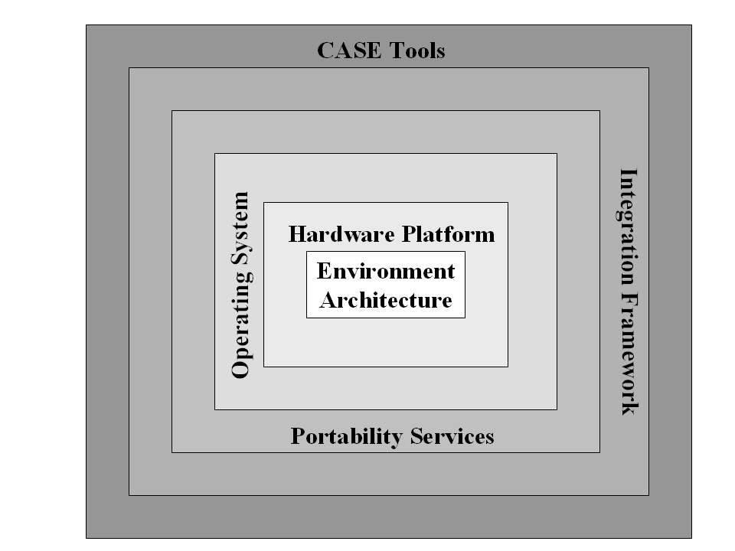
Complete CASE Environment

Slide 24
CASE Tools - Need
Size of projects
Requires systematization of development process
User requirements
Supports principles reusability, flexibility, maintainability of programs
The Development process needs clear understanding and documentation
‘Zero defect’ software

Slide 25
Evolution of CASE
Early 1980s
  Had diagramming capabilities
Late 1980s
  Development of tools that could store diagram information
  Perform cross-diagram checks through a repository
The 1990s
  Integration of project management and system lifecycle activities
  Included automatic code generation
Late 1990s
  Integrated CASE framework where different CASE vendor products can be integrated

Slide 26
CASE Environment
Analysis Tools
Prototyping Tools
Dictionary browsing & hypertext
Design Tools
Computer Workstation
Central Data Repository
Code Generation
Reverse Engineering Tools
DBMS Interface
Querying & Reporting
Project Management Tools

Slide 27
CASE Terminologies
CASE Technology
CASE Tool
CASE Toolkit
CASE Workbench
CASE Methodology
CASE Methodology Companion
CASE Hardware

Slide 28
CASE Tools - Classifications
Tool
Toolkit
Methodology Companion
Workbench

Slide 29
CASE Tools - Types
Diagramming
Prototyping
Simulation
Support
Quality Assurance
Software Configuration Management
Re-engineering tools
Reverse Engineering
Documentation

Slide 30
CASE Toolkits
Analysis
Design
Programming
Project Management
Maintenance

Slide 31
CASE Workbench
Consists of tools that cover and integrate entire SDLC
Offers a choice of tools and techniques
Ensures that the output of one phase successfully becomes the input for another phase

Slide 32
CASE - Advantages
Takes project from inception to implementation
Assures smooth flow from one stage to another
Error checking is easier
A CASE workbench contains the ‘information repository’

Slide 33
Summary
Implementation is a very important phase of SDLC.
There are no standard methodologies for implementation.
The important activities of the implementation phase are:
  Drawing up an Installation Plan
  Implementing of Physical Procedures
  Data Preparation and Conversion
  Conducting User Training
  Parallel run of the system
  Seeking Implementation Approval
The choice of an appropriate implementation strategy is critical to the successful implementation of any project.

Slide 34
Summary Contd…
The implementation is usually followed by post-implementation maintenance phase.
CASE automates the process of software development.
The essential components of a CASE are tools, toolkits, methodology companions and workbenches.
The important toolkits being commonly used today are:
  Analysis toolkits
  Design toolkits
  Programming toolkits
  Project Management toolkits
  Maintenance toolkits
CASE is in the process of becoming an integral part of every software organization.

